Slide 1
Corporate Computer Security, 4th Edition
Randall J. Boyle & Raymond R. Panko
Chapter 2
Planning and Policy

Slide 2
Learning Objectives
Justify the need for formal management processes.
Explain the plan–protect–respond security management cycle.
Describe compliance laws and regulations.
Describe organizational security issues.
Describe risk analysis.
Describe technical security infrastructure.
Explain policy-driven implementation.
Know governance frameworks.

Slide 3
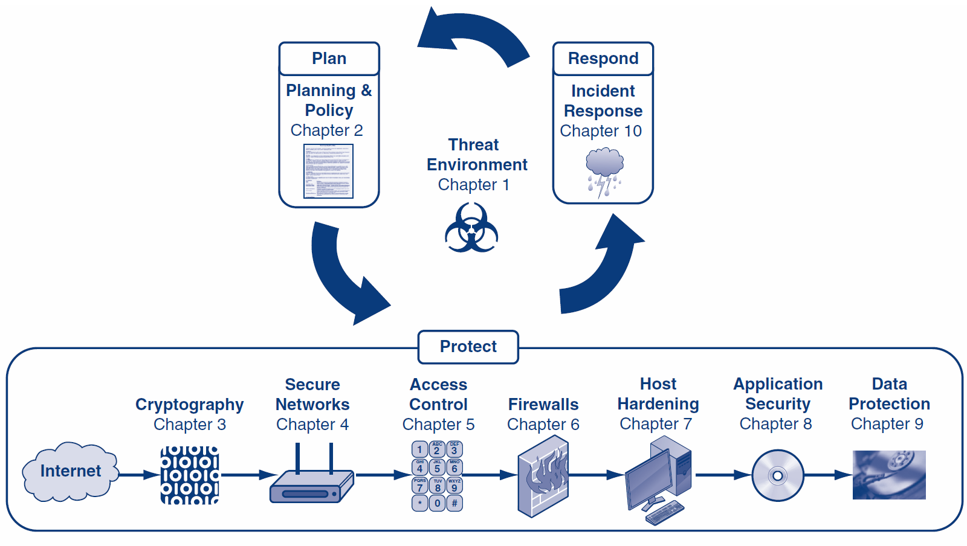

Slide 4
Orientation
The first chapter focused on threats
The rest of the book focuses on defense
In this chapter, we will see that defensive thinking is build around the plan-protect-respond cycle
In this chapter, we will focus on planning
Chapters 3 to 9 focus on protection
Chapter 10 focuses on response

Slide 5
What’s Next?
2.1 Introduction & Terminology
2.2 Compliance Laws and Regulations
2.3 Organization
2.4 Risk Analysis
2.5 Technical Security Architecture
2.6 Policy-Driven Implementation
2.7 Governance Frameworks

Slide 6
2.1: Management is the Hard Part
Technology Is Concrete
Can visualize devices and transmission lines
Can understand device and software operation
Management Is Abstract
Management Is More Important
Security is a process, not a product (Bruce Schneier)

Slide 7
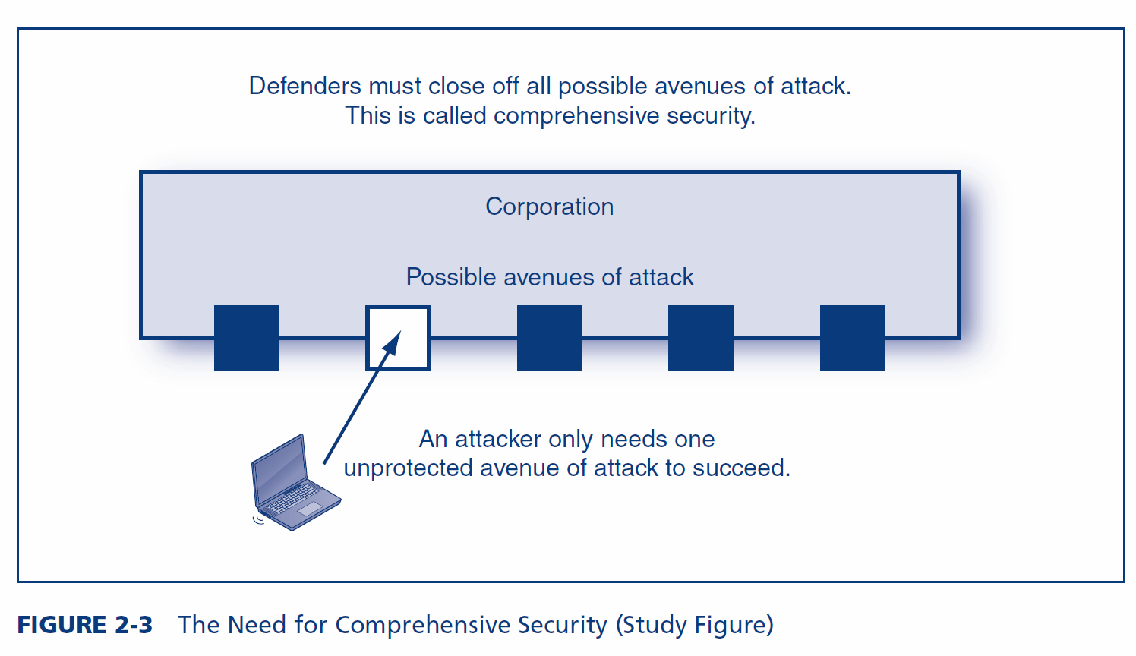
2.1: The Need for Comprehensive Security

Slide 8
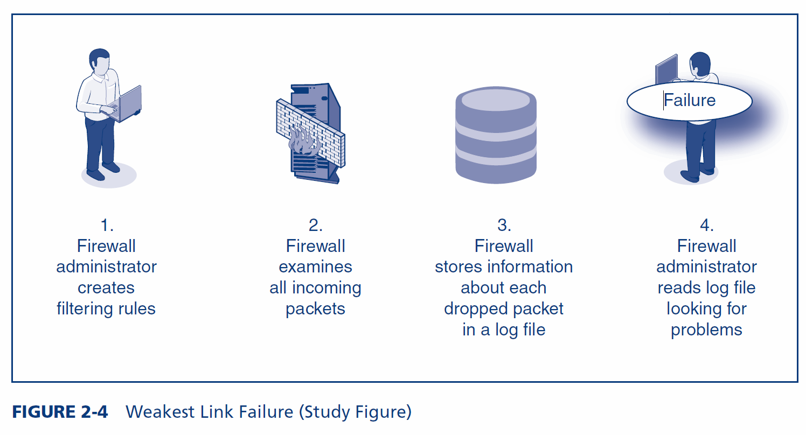
2.1: Weakest Link Failure
A failure in any component will lead to failure for the entire system

Slide 9
2.1: Security Management Is a Disciplined Process
Complex
Cannot be managed informally
Need Formal Processes
Planned series of actions in security management
Annual planning
Processes for planning and developing individual countermeasures

Slide 10
2.1: Security Management Is a Disciplined Process
A Continuous Process
Fail if let up
Compliance Regulations
Add to the need to adopt disciplined security management processes

Slide 11
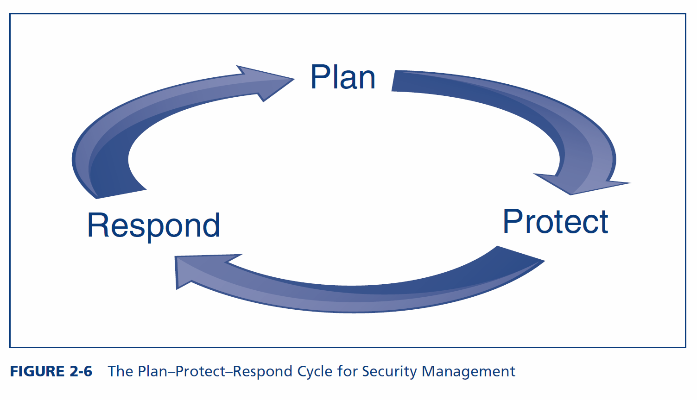
2.1: The Plan-Protect-Respond Cycle for Security Management
Dominates security management thinking

Slide 12
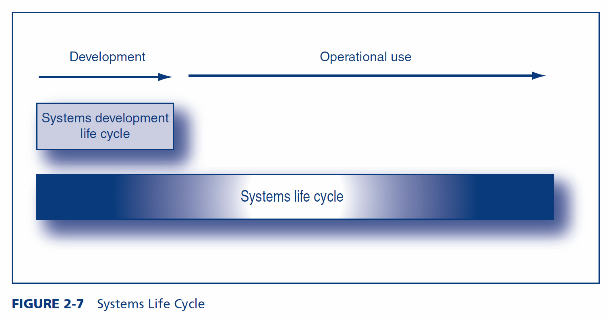
2.1: Systems Life Cycle
The systems life cycle goes beyond the SDLC, to include operational use. SLC thinking is critical in security.

Slide 13
2.1: Vision
Vision
Your understanding about your role with respect to your company, its employees, and the outside world drives everything else

Slide 14
2.1: Vision
Security as an Enabler
Security is often thought of as a preventer
But security is also an enabler
A company with good security can do things otherwise impossible
Engage in interorganizational systems with other firms
Can use SNMP SET commands to manage systems remotely
Must get in early on projects to reduce inconvenience

Slide 15
2.1: Vision
Positive Vision of Users
Must not view users as malicious or stupid
Stupid means poorly trained, and that is security’s fault
Must have zero tolerance for negative views of users

Slide 16
2.1: Vision
Should Not View Security as Police or Military Force
Creates a negative view of users
Police merely punish, they do not prevent crime; security must prevent attacks
Military can use fatal force; security cannot even punish (HR does that)

Slide 17
2.1: Vision
Need New Vision
Mother nurturing inexperienced offspring
Cannot Be Effective Unless Users Work with You
Consultation, consultation, consultation

Slide 18
2.1: Strategic IT Security Planning
Identify Current IT Security Gaps
Identify Driving Forces
The threat environment
Compliance laws and regulations
Corporate structure changes, such as mergers
Identify Corporate Resources Needing Protection
Enumerate all resources
Rate each by sensitivity

Slide 19
2.1: Strategic IT Security Planning
Develop Remediation Plans
Develop a remediation plan for all security gaps
Develop a remediation plan for every resource unless it is well protected
Develop an Investment Portfolio
You cannot close all gaps immediately
Choose projects that will provide the largest returns
Implement these

Slide 20
What’s Next?
2.1 Introduction & Terminology
2.2 Compliance Laws and Regulations
2.3 Organization
2.4 Risk Analysis
2.5 Technical Security Architecture
2.6 Policy-Driven Implementation
2.7 Governance Frameworks

Slide 21
2.2: Legal Driving Forces
Compliance Laws and Regulations
Compliance laws and regulations create requirements for corporate security
Documentation requirements are strong
Identity management requirements tend to be strong
Compliance can be expensive
There are many compliance laws and regulations, and the number is increasing rapidly

Slide 22
2.2: Legal Driving Forces
Sarbanes–Oxley Act of 2002
Massive corporate financial frauds in 2002
Act requires firm to report material deficiencies in financial reporting processes
Material deficiency a significant deficiency, or combination of significant deficiencies, that results in more than a remote likelihood that a material misstatement of the annual or interim financial statements will not be prevented or detected

Slide 23
2.2: Legal Driving Forces
Sarbanes–Oxley Act of 2002
Note that it does not matter whether a material misstatement actually occurs—merely that there is more than a remote likelihood that it could occur and not be detected
A material deviation is a mere 5% deviation
Companies that report material deficiencies typically find that their stock loses value, and the chief financial officer may lose his or her job

Slide 24
2.2: Legal Driving Forces
Privacy Protection Laws
The European Union (E.U.) Data Protection Directive of 2002
Many other nations have strong commercial data privacy laws
The U.S. Gramm–Leach–Bliley Act (GLBA)
The U.S. Health Insurance Portability and Accountability Act (HIPAA) for private data in health care organizations

Slide 25
2.2: Legal Driving Forces
Data Breach Notification Laws
California’s SB 1386
Requires notification of any California citizen whose private information is exposed
Companies cannot hide data breaches anymore
Federal Trade Commission (FTC)
Can punish companies that fail to protect private information
Fines and required external auditing for several years

Slide 26
2.2: Legal Driving Forces
Industry Accreditation
For hospitals, etc.
Often have to security requirements
PCS-DSS
Payment Card Industry–Data Security Standards
Applies to all firms that accept credit cards
Has 12 general requirements, each with specific subrequirements

Slide 27
2.2: Legal Driving Forces
FISMA
Federal Information Security Management Act of 2002
Processes for all information systems used or operated by a U.S. government federal agencies
Also by any contractor or other organization on behalf of a U.S. government agency
Certification, followed by accreditation
Continuous monitoring
Criticized for focusing on documentation instead of protection

Slide 28
What’s Next?
2.1 Introduction & Terminology
2.2 Compliance Laws and Regulations
2.3 Organization
2.4 Risk Analysis
2.5 Technical Security Architecture
2.6 Policy-Driven Implementation
2.7 Governance Frameworks

Slide 29
2.3: Organizational Issues
Chief Security Officer (CSO)
Also called chief information security officer (CISO)
Where to Locate IT Security?
Within IT
Compatible technical skills
CIO will be responsible for security
Outside of IT
Gives independence
Hard to blow the whistle on IT and the CIO
This is the most commonly advised choice

Slide 30
2.3: Organizational Issues
Where to Locate IT Security?
Hybrid
Place planning, policy making, and auditing outside of IT
Place operational aspects such as firewall operation within IT

Slide 31
2.3: Organizational Issues
Top Management Support
Budget
Support in conflicts
Setting personal examples

Slide 32
2.3: Organizational Issues
Relationships with Other Departments
Special relationships
Ethics, compliance, and privacy officers
Human resources (training, hiring, terminations, sanction violators)
Legal department

Slide 33
2.3: Organizational Issues
Relationships with Other Departments
Special relationships
Auditing departments
IT auditing, internal auditing, financial auditing
Might place security auditing under one of these
This would give independence from the security function
Facilities (buildings) management
Uniformed security

Slide 34
2.3: Organizational Issues
Relationships with Other Departments
All corporate departments
Cannot merely toss policies over the wall
Business partners
Must link IT corporate systems together
Before doing so, must exercise due diligence in assessing their security

Slide 35
2.3: Organizational Issues
Outsourcing IT Security
Only e-mail or webservice
Managed Security Service Providers (MSSPs)
Outsource most IT security functions to the MSSP
But usually not policy

Slide 36
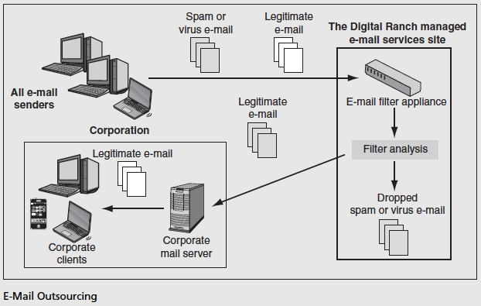
2.3: E-Mail Outsourcing

Slide 37
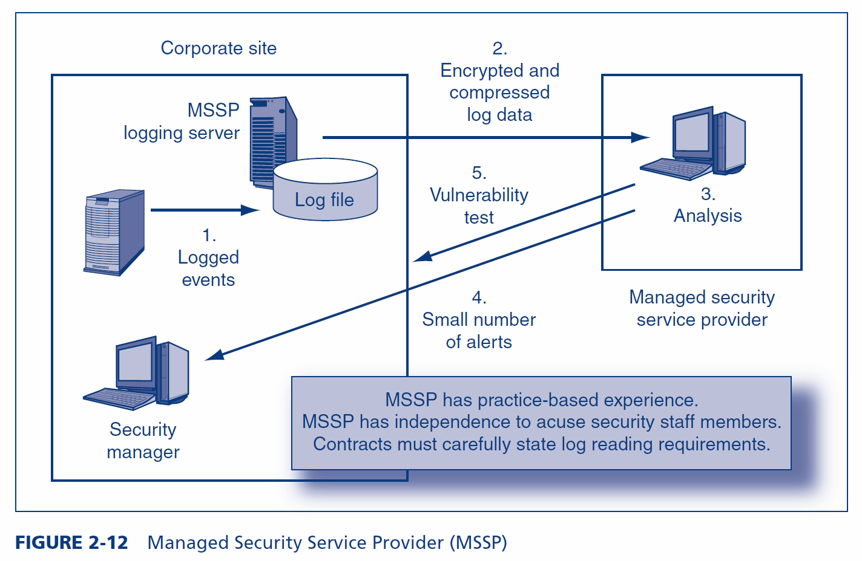
2.3: Managed Security Service Provider (MSSP)

Slide 38
What’s Next?
2.1 Introduction & Terminology
2.2 Compliance Laws and Regulations
2.3 Organization
2.4 Risk Analysis
2.5 Technical Security Architecture
2.6 Policy-Driven Implementation
2.7 Governance Frameworks

Slide 39
2.4: Risk Analysis
Realities
Can never eliminate risk
“Information assurance” is impossible
Risk Analysis
Goal is reasonable risk
Risk analysis weighs the probable cost of compromises against the costs of countermeasures
Also, security has negative side effects that must be weighed

Slide 40
2.4: Risk Analysis
Asset Value (AV)
X Exposure Factor (EF)
Percentage loss in asset value if a compromise occurs
= Single Loss Expectancy (SLE)
Expected loss in case of a compromise
SLE
X Annualized Rate of Occurrence (ARO)
Annual probability of a compromise
= Annualized Loss Expectancy (ALE)
Expected loss per year from this type of compromise
Single Loss Expectancy (SLE)
Annualized Loss Expectancy (ALE)

Slide 41
2.4: Classic Risk Analysis Calculation
 | Base Case | Countermeasure
 |  | A
Asset Value (AV) | $100,000 | $100,000
Exposure Factor (EF) | 80% | 20%
Single Loss Expectancy (SLE): = AV*EF | $80,000 | $20,000
Annualized Rate of Occurrence (ARO) | 50% | 50%
Annualized Loss Expectancy (ALE): = SLE*ARO | $40,000 | $10,000
ALE Reduction for Countermeasure | NA | $30,000
Annualized Countermeasure Cost | NA | $17,000
Annualized Net Countermeasure Value | NA | $13,000
Countermeasure A should reduce the exposure factor by 75%

Slide 42
2.4: Classic Risk Analysis Calculation
 | Base Case | Countermeasure
 |  | B
Asset Value (AV) | $100,000 | $100,000
Exposure Factor (EF) | 80% | 80%
Single Loss Expectancy (SLE): = AV*EF | $80,000 | $80,000
Annualized Rate of Occurrence (ARO) | 50% | 25%
Annualized Loss Expectancy (ALE): = SLE*ARO | $40,000 | $20,000
ALE Reduction for Countermeasure | NA | $20,000
Annualized Countermeasure Cost | NA | $4,000
Annualized Net Countermeasure Value | NA | $16,000
Countermeasure B should cut the frequency of compromises in half

Slide 43
2.4: Classic Risk Analysis Calculation
 | Base Case | Countermeasure
 |  | A | B
Asset Value (AV) | $100,000 | $100,000 | $100,000
Exposure Factor (EF) | 80% | 20% | 80%
Single Loss Expectancy (SLE): = AV*EF | $80,000 | $20,000 | $80,000
Annualized Rate of Occurrence (ARO) | 50% | 50% | 25%
Annualized Loss Expectancy (ALE): = SLE*ARO | $40,000 | $10,000 | $20,000
ALE Reduction for Countermeasure | NA | $30,000 | $20,000
Annualized Countermeasure Cost | NA | $17,000 | $4,000
Annualized Net Countermeasure Value | NA | $13,000 | $16,000
Although Countermeasure A reduces the ALE more,
Countermeasure B is much less expensive.
The annualized net countermeasure value for B is larger.
The company should select Countermeasure B.

Slide 44
2.4: Problems with Classic Risk Analysis Calculations
Uneven Multiyear Cash Flows
For both attack costs and defense costs
Must compute the return on investment (ROI) using discounted cash flows
Net present value (NPV) or internal rate of return (ROI)

Slide 45
2.4: Problems with Classic Risk Analysis Calculations
Total Cost of Incident (TCI)
Exposure factor in classic risk analysis assumes that a percentage of the asset is lost
In most cases, damage does not come from asset loss
For instance, if personally identifiable information is stolen, the cost is enormous but the asset remains
Must compute the total cost of incident (TCI)
Include the cost of repairs, lawsuits, and many other factors

Slide 46
2.4: Problems with Classic Risk Analysis Calculations
Many-to-Many Relationships between Countermeasures and Resources
Classic risk analysis assumes that one countermeasure protects one resource
Single countermeasures, such as a firewall, often protect many resources
Single resources, such as data on a server, are often protected by multiple countermeasures
Extending classic risk analysis is difficult

Slide 47
2.4: Problems with Classic Risk Analysis Calculations
Impossibility of Knowing the Annualized Rate of Occurrence
There simply is no way to estimate this
This is the worst problem with classic risk analysis
As a consequence, firms too often merely rate their resources by risk level

Slide 48
2.4: Problems with Classic Risk Analysis Calculations
Problems with “Hard-Headed Thinking”
Security benefits are difficult to quantify
If only support “hard numbers,” may underinvest in security

Slide 49
2.4: Problems with Classic Risk Analysis Calculations
Perspective
Impossible to do perfectly
Must be done as well as possible
Identifies key considerations
Works if countermeasure value is very large or very negative
But never take classic risk analysis seriously

Slide 50
2.4: Responding to Risk
Risk Reduction
The approach most people consider
Install countermeasures to reduce harm
Makes sense only if risk analysis justifies the countermeasure
Risk Acceptance
If protecting against a loss would be too expensive, accept losses when they occur
Good for small unlikely losses
Good for large but rare losses

Slide 51
2.4: Responding to Risk
Risk Transference
Buy insurance against security-related losses
Especially good for rare but extremely damaging attacks
Does not mean a company can avoid working on IT security
If bad security, will not be insurable
With better security, will pay lower premiums

Slide 52
2.4: Responding to Risk
Risk Avoidance
Not to take a risky action
Lose the benefits of the action
May cause anger against IT security
Recap: Four Choices When You Face Risk
Risk reduction
Risk acceptance
Risk transference
Risk avoidance

Slide 53
What’s Next?
2.1 Introduction & Terminology
2.2 Compliance Laws and Regulations
2.3 Organization
2.4 Risk Analysis
2.5 Technical Security Architecture
2.6 Policy-Driven Implementation
2.7 Governance Frameworks

Slide 54
2.5: Corporate Technical Security Architecture
Technical Security Architectures
Definition
All of a company’s technical countermeasures
How these countermeasures are organized
Into a complete system of protection
Architectural decisions
Based on the big picture
Must be well planned to provide strong security with few weaknesses

Slide 55
2.5: Corporate Technical Security Architecture
Technical Security Architectures
Dealing with legacy technologies
Legacy technologies are technologies put in place previously
Too expensive to upgrade all legacy technologies immediately
Must upgrade if seriously impairs security
Upgrades must justify their costs

Slide 56
2.5: Corporate Technical Security Architecture
Principles
Defense in depth
Resource is guarded by several countermeasures in series
Attacker must breach them all, in series, to succeed
If one countermeasure fails, the resource remains safe

Slide 57
2.5: Corporate Technical Security Architecture
Principles
Defense in depth versus weakest links
Defense in depth: multiple independent countermeasures that must be defeated in series
Weakest link: a single countermeasure with multiple interdependent components that must all succeed for the countermeasure to succeed

Slide 58
2.5: Corporate Technical Security Architecture
Principles
Avoiding single points of vulnerability
Failure at a single point can have drastic consequences
DNS servers, central security management servers, etc.

Slide 59
2.5: Corporate Technical Security Architecture
Principles
Minimizing security burdens
Realistic goals
Cannot change a company’s protection level overnight
Mature as quickly as possible

Slide 60
2.5: Corporate Technical Security Architecture
Elements of a Technical Security Architecture
Border management
Internal site management
Management of remote connections
Interorganizational systems with other firms
Centralized security management
Increases the speed of actions
Reduces the cost of actions

Slide 61
What’s Next?
2.1 Introduction & Terminology
2.2 Compliance Laws and Regulations
2.3 Organization
2.4 Risk Analysis
2.5 Technical Security Architecture
2.6 Policy-Driven Implementation
2.7 Governance Frameworks

Slide 62
2.6: Policies
Policies
Statements of what is to be done
Provide clarity and direction
Does not specify in detail how the policy is to be implemented in specific circumstances
Allows the best possible implementation at any time
Vary widely in length

Slide 63
2.6: Policies
Tiers of Security Policies
Brief corporate security policy to drive everything
Major policies
E-mail
Hiring and firing
Personally identifiable information
…

Slide 64
2.6: Policies
Tiers of Security Policies
Acceptable use policy
Summarizes key points of special importance for users
Typically, must be signed by users
Policies for specific countermeasures
Again, separates security goals from implementation

Slide 65
2.6: Policies
Writing Policies
For important policies, IT security cannot act alone
There should be policy-writing teams for each policy
For broad policies, teams must include IT security, management in affected departments, the legal department, and so forth
The team approach gives authority to policies
It also prevents mistakes because of IT security’s limited viewpoint

Slide 66
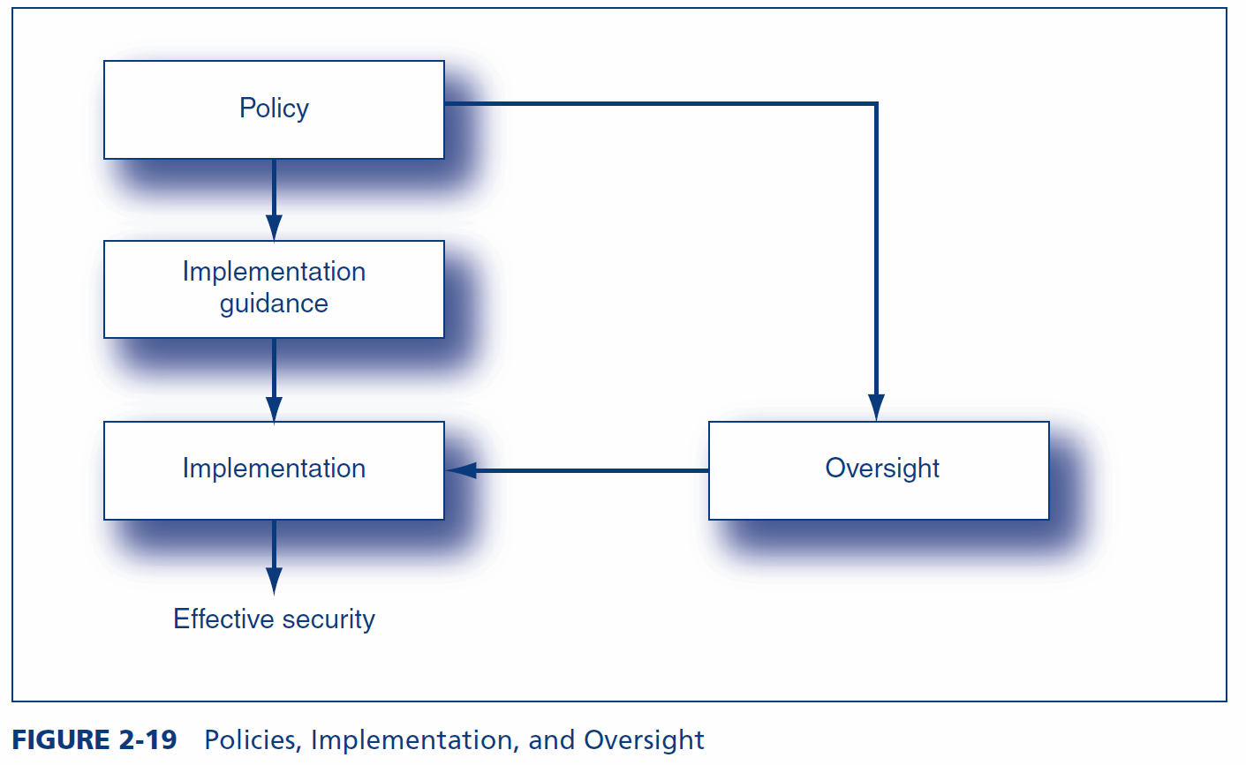
2.6: Policies, Implementation, and Oversight

Slide 67
2.6: Implementation Guidance
Implementation Guidance
Limits the discretion of implementers in order to simplify implementation decisions and avoid bad choices in interpreting policies
None
Implementer is only guided by the policy itself
Standards versus Guidelines
Standards are mandatory directives
Guidelines are not mandatory but must be considered

Slide 68
2.6: Implementation Guidance
Types of Implementation Guidance
Procedures: detailed specifications for how something should be done
Can be either standards or guidelines
Segregation of duties: two people are required to complete sensitive tasks
In movie theaters, one sells tickets and the other takes tickets
No individual can do damage

Slide 69
2.6: Implementation Guidance
Types of Implementation Guidance
Procedures
Request/authorization control
Limit the number of people who may make requests on sensitive matters
Allow even fewer to be able to authorize requests
Authorizer must never be the requester
Mandatory vacations to uncover schemes that require constant maintenance
Job rotation to uncover schemes that require constant maintenance

Slide 70
2.6: Implementation Guidance
Types of Implementation Guidance
Procedures: detailed descriptions of what should be done
Processes: less detailed specifications of what actions should be taken
Necessary in managerial and professional business function
Baselines: checklists of what should be done but not the process or procedures for doing them

Slide 71
2.6: Implementation Guidance
Types of Implementation Guidance
Best practices: most appropriate actions in other companies
Recommended practices: normative guidance
Accountability
Owner of resource is accountable
Implementing the policy can be delegated to a trustee, but accountability cannot be delegated
Codes of ethics

Slide 72
2.6: Ethics
Ethics
A person’s system of values
Needed in complex situations
Different people may make different decisions in the same situation
Companies create codes of ethics to give guidance in ethical decisions

Slide 73
2.6: Ethics
Code of Ethics: Typical Contents (Partial List)
Important for having a good workplace and to avoid damaging a firm’s reputation
Applies to everybody
Senior managers usually have additional requirements
Improper ethics can result in sanctions, up to and including termination
An employee must report observed unethical behavior

Slide 74
2.6: Ethics
Code of Ethics: Typical Contents (Partial List)
An employee must involve conflicts of interest
Never exploit one’s position for personal gain
No preferential treatment of relatives
No investing in competitors
No competing with the company while still employed by the firm

Slide 75
2.6: Ethics
Code of Ethics: Typical Contents (Partial List)
No bribes or kickbacks
Bribes are given by outside parties to get preferential treatment
Kickbacks are given by sellers when they place an order to secure this or future orders
Employees must use business assets for business uses only, not personal use

Slide 76
2.6: Ethics
Code of Ethics: Typical Contents (Partial List)
An employee may never divulge
Confidential information
Private information
Trade secrets

Slide 77
2.6: Exception Handling
Exceptions Are Always Required
But they must be managed
Limiting Exceptions
Only some people should be allowed to request exceptions
Fewer people should be allowed to authorize exceptions
The person who requests an exception must never be authorizer

Slide 78
2.6: Exception Handling
Exception Must be Carefully Documented
Specifically what was done and who did each action
Special Attention Should be Given to Exceptions in Periodic Auditing
Exceptions Above a Particular Danger Level
Should be brought to the attention of the IT security department and the authorizer’s direct manager

Slide 79
2.6: Oversight
Oversight
Oversight is a group of tools for policy enforcement
Policy drives oversight, just as it drives implementation
Promulgation
Communicate vision
Training
Stinging employees?

Slide 80
2.6: Oversight
Electronic Monitoring
Electronically-collected information on behavior
Widely done in firms and used to terminate employees
Warn subjects and explain the reasons for monitoring

Slide 81
2.6: Oversight
Security Metrics
Indicators of compliance that are measured periodically
Percentage of passwords on a server that are crackable, etc.
Periodic measurement indicates progress in implementing a policy

Slide 82
2.6: Oversight
Auditing
Samples information to develop an opinion about the adequacy of controls
Database information in log files and prose documentation
Extensive recording is required in most performance regimes
Avoidance of compliance is a particularly important finding

Slide 83
2.6: Oversight
Auditing
Internal and external auditing may be done
Periodic auditing gives trends
Unscheduled audits trip up people who plan their actions around periodic audits

Slide 84
2.6: Oversight
Anonymous Protected Hotline
Employees are often the first to detect a serious problem
A hotline allows them to call it in
Must be anonymous and guarantee protection against reprisals
Offer incentives for heavily damaging activities such as fraud?

Slide 85
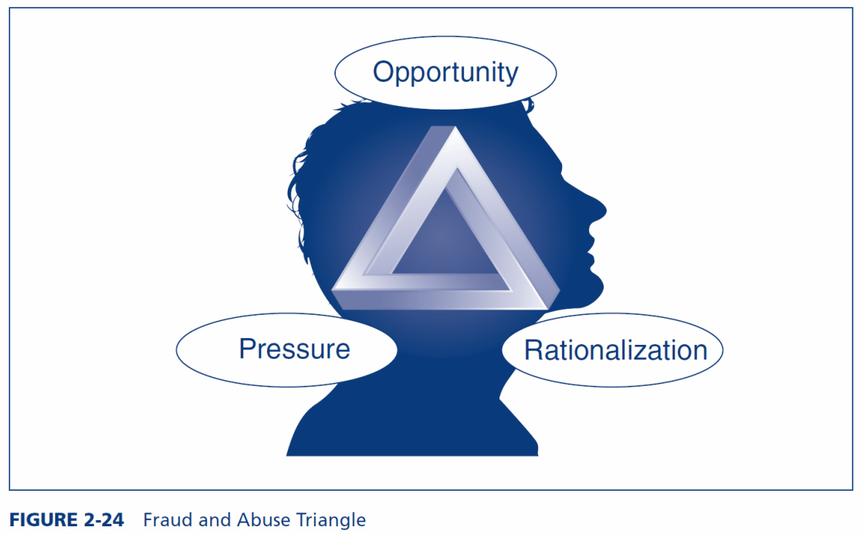
2.6: Oversight
Behavioral Awareness
Misbehavior often occurs before serious security breaches
The fraud triangle indicates motive.

Slide 86
2.6: Oversight
Vulnerability Tests
Attack your own systems to find vulnerabilities
Free and commercial software
Never test without a contract specifying the exact tests, signed by your superior
The contract should hold you blameless in case of damage

Slide 87
2.6: Oversight
Vulnerability Tests
External vulnerability testing firms have expertise and experience
They should have insurance against accidental harm and employee misbehavior
They should not hire hackers or former hackers
Should end with a list of recommended fixes
Follow-up should be done on whether these fixes occurred

Slide 88
2.6: Oversight
Sanctions
If people are not punished when they are caught, nothing else matters

Slide 89
What’s Next?
2.1 Introduction & Terminology
2.2 Compliance Laws and Regulations
2.3 Organization
2.4 Risk Analysis
2.5 Technical Security Architecture
2.6 Policy-Driven Implementation
2.7 Governance Frameworks

Slide 90
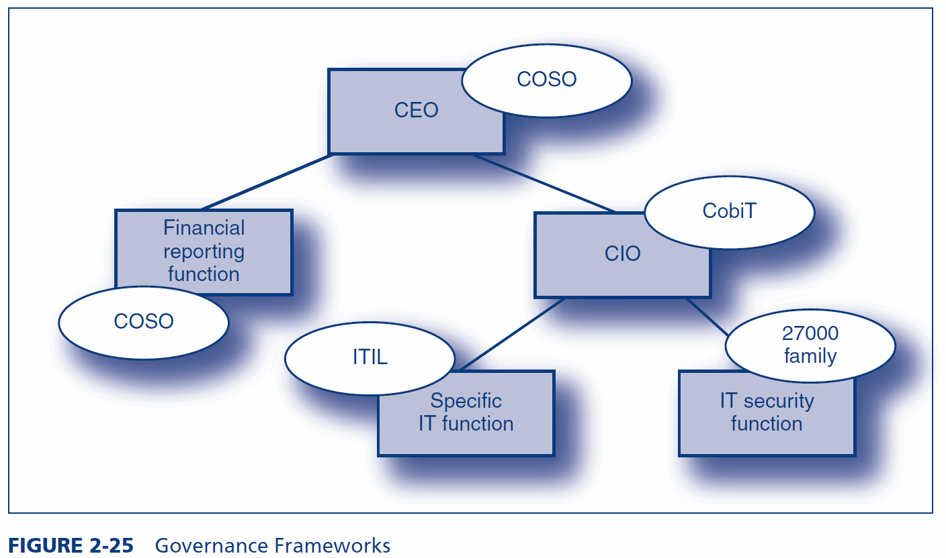
2.7: Governance Frameworks

Slide 91
2.7: COSO
Origins
Committee of Sponsoring Organizations of the Treadway Commission (www.coso.org)
Ad hoc group to provide guidance on financial controls
Focus
Corporate operations, financial controls, and compliance
Effectively required for Sarbanes–Oxley compliance
Goal is reasonable assurance that goals will be met

Slide 92
2.7: COSO
Components
Control Environment
General security culture
Includes “tone at the top”
If strong, weak specific controls may be effective
If weak, strong controls may fail
Major insight of COSO

Slide 93
2.7: COSO
Components
Risk assessment
Ongoing preoccupation
Control activities
General policy plus specific procedures

Slide 94
2.7: COSO
Components
Monitoring
Both human vigilance and technology
Information and communication
Must ensure that the company has the right information for controls
Must ensure communication across all levels in the corporation

Slide 95
2.7: CobiT
CobiT
Control Objectives for Information and Related Technologies
CIO-level guidance on IT governance
Offers many documents that help organizations understand how to implement the framework

Slide 96
2.7: CobiT
The CobiT Framework
Four major domains
34 high-level control objectives
Planning and organization (10)
Acquisition and implementation (7)
Delivery and support (13)
Monitoring (4)
More than 300 detailed control objectives

Slide 97
2.7: CobiT
Dominance in the United States
Created by the IT governance institute
Part of the Information Systems Audit and Control Association (ISACA)
ISACA is the main professional accrediting body of IT auditing
Certified information systems auditor (CISA) certification

Slide 98
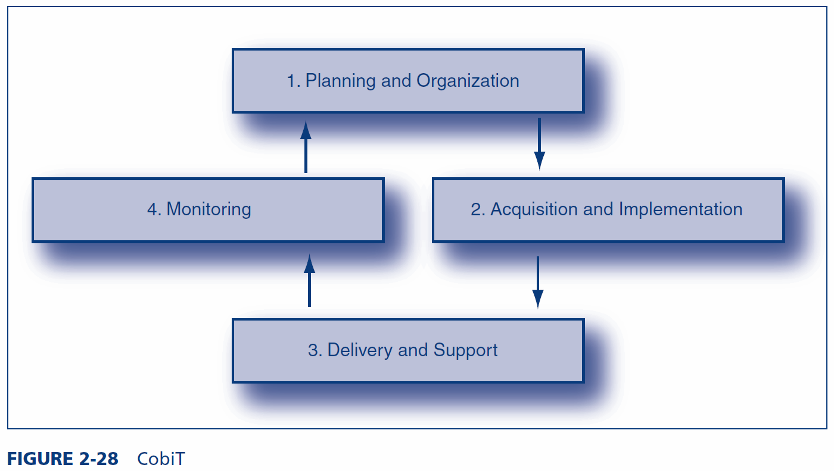
2.7: CobiT
The CobiT Framework
Four major domains (Figure 2-28)

Slide 99
2.7: The ISO/IEC 27000 Family of Security Standards
ISO/IEC 27000
Family of IT security standards with several individual standards
From the International Organization for Standardization (ISO) and the International Electrotechnical Commission (IEC)
ISO/IEC 27002
Originally called ISO/IEC 17799
Recommendations in 11 broad areas of security management

Slide 100
2.7: The ISO/IEC 27000 Family of Security Standards
ISO/IEC 27002: Eleven Broad Areas
Security policy | Access control
Organization of information security | Information systems acquisition, development and maintenance
Asset management | Information security incident management
Human resources security | Business continuity management
Physical and environmental security | Compliance
Communications and operations management

Slide 101
2.7: The ISO/IEC 27000 Family of Security Standards
ISO/IEC 27001
Created in 2005, long after ISO/IEC 27002
Specifies certification by a third party
COSO and CobiT permit only self-certification
Business partners prefer third-party certification
Other 27000 Standards
Many more 27000 standards documents are under preparation

Slide 102
The End

Slide 103
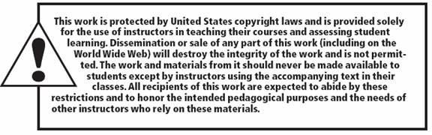
All rights reserved. No part of this publication may be reproduced, stored in a retrieval system, or transmitted, in any form or by any means, electronic, mechanical, photocopying, recording, or otherwise, without the prior written permission of the publisher. Printed in the United States of America.
Copyright © 2015 Pearson Education, Inc.

